Slide 1


HEP NTUA Weekly Report 17/5/2021
George Bakas

Slide 2
Summary
ttX analysis:
Variation Handling
Validation with Giannis
JES, PS, PDF, Scale and bTag variations for 2017 and 2018
For each variation:
Histograms (0 and 2 btag), Response Matrices
Fit jetMassSoftDrop in Extended SR
Signal Extraction (Transfer Factors, etc)
Unfolding
Z’ analysis:
Sliding mJJ cut
Added Variations in Datacard
PS, PDF(RMS), Scale (RMS), bTag for 2017 and 2018
JES 2018 only
For each variation
Up, Down variation
Added it into datacard as ttbar variation
Brazilian Plots for 2017 and 2018

Slide 3
Datacard Summary (example for mJJ > 1600 GeV)
imax * number of bins
jmax * number of processes minus 1
kmax * number of nuisance parameters
----------------------------------------------------------------------------
shapes * SR_C ProcessesFile_1600.root h_chi_$PROCESS h_chi_$PROCESS_$SYSTEMATIC
shapes Zprime SR_C ZprimeFile_2000_20_massCut1600.root h_chi_$PROCESS
shapes data_obs SR_C DataFile_1600.root h_Data
----------------------------------------------------------------------------
bin SR_C
observation -1.0
----------------------------------------------------------------------------
bin SR_C SR_C SR_C SR_C
process Zprime qcd Subdominant ttbar
process 0 1 2 3
rate -1.0 -1.0 -1.0 -1.0
----------------------------------------------------------------------------
yield_ttbar lnN - - - 1.5
yield_qcd lnN - 1.5 - -
yield_Subdominant lnN - - 1.5 -
lumi_13TeV lnN - 1.025 1.025 1.025
scale shapeN - - - 1.0
pdf shapeN - - - 1.0
fsr shapeN - - - 1.0
isr shapeN - - - 1.0
JES shapeN - - - 1.0
btag shapeN - - - 1.0
* autoMCStats 10 1

Slide 4
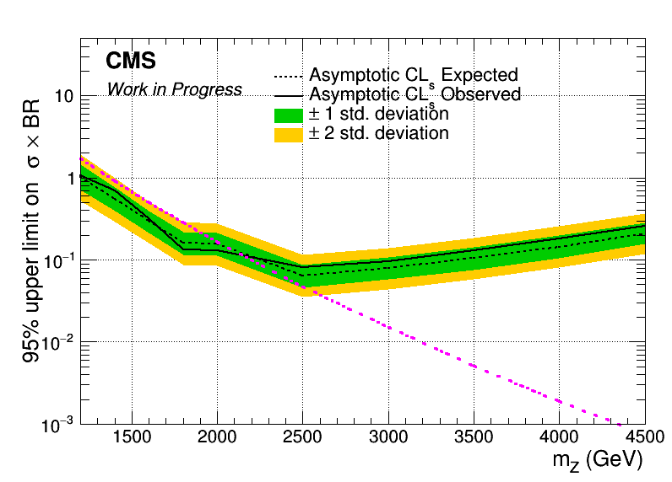
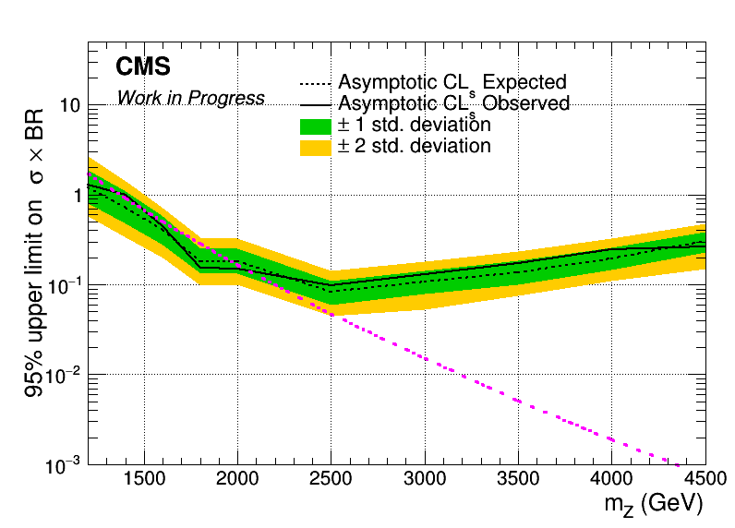
Brazilian Plots (2017 and 2018) with sliding mJJ Cut
Mass Cut Mapping
{"mZ_1200_12":1000, "mZ_1400_14":1200, "mZ_1600_16":1400, "mZ_1800_18":1600, "mZ_2000_20":1600,
"mZ_2500_25":2000, "mZ_3000_30":2000, "mZ_3500_35":2000, "mZ_4000_40":2000, "mZ_4500_45":2000}
2017
2017 with systematics (no JES)

Slide 5
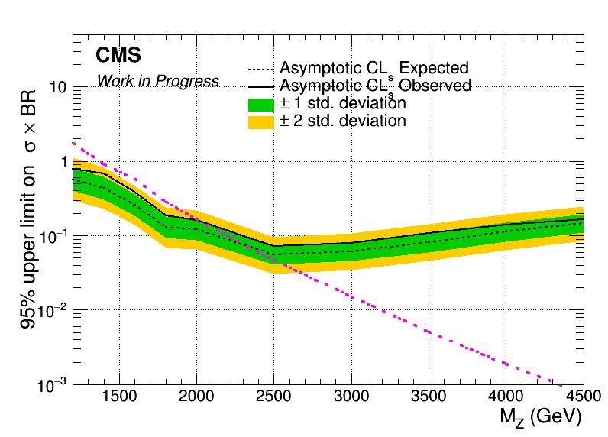
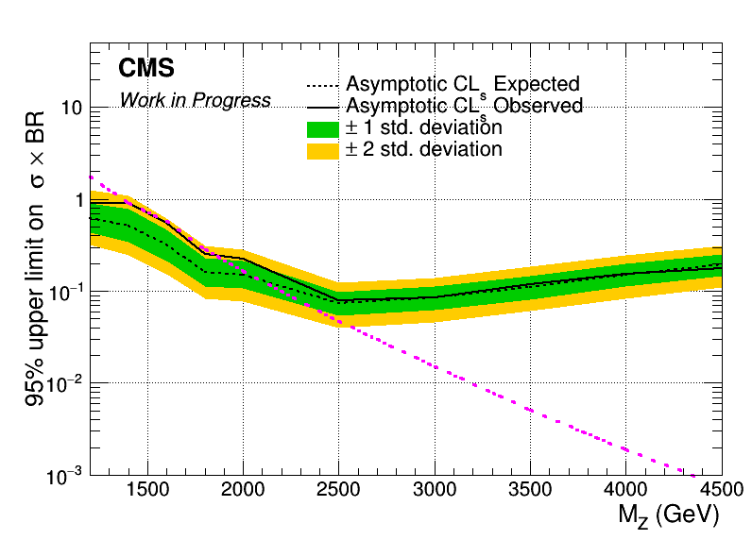
Brazilian Plots (2017 and 2018) with sliding mJJ Cut
Mass Cut Mapping
{"mZ_1200_12":1000, "mZ_1400_14":1200, "mZ_1600_16":1400, "mZ_1800_18":1600, "mZ_2000_20":1600,
"mZ_2500_25":2000, "mZ_3000_30":2000, "mZ_3500_35":2000, "mZ_4000_40":2000, "mZ_4500_45":2000}
2018
2018 with systematics

Slide 6
ttX and Z’ files UL (19 and 20)
Two different issues in the Summer19 campaign:
A bug in Pythia related to fragmentation
Affects all years (2016/2017/2018)
Marginal/negligible effects.
A bug in the beamspot position that affects only (most of the) 2016 samples (both pre and post VFP)
The impact on physics (e.g. JECs, lepton impact parameter, etc...) is large
Recommendation:
For 2017 and 2018, Summer19 samples are allowed for analyses (and in fact used by many POGs for SF measurement), as long as the corresponding Summer 20 samples are missing
For 2016, only Summer20 samples can be used.
Z’ UL files
We only have Z’ 1% mass width files for 2016_preVFP (20UL), 2017 (both UL 19 and 20), 2018 (both UL 19 and 20)
Status of other files in production:
0% for all Z’ files !!

Slide 7
ttX and Z’ files UL (19 and 20)

Slide 8
ttX and Z’ files UL (19 and 20)

Slide 9
ttX and Z’ files UL (19 and 20)

Slide 10
BACKUP

Slide 11
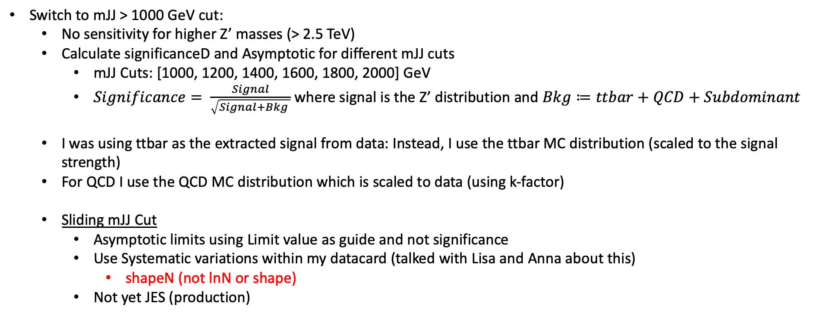
Summary Z’ Analysis
Switch to mJJ > 1000 GeV cut:
No sensitivity for higher Z’ masses (> 2.5 TeV)
Calculate significanceD and Asymptotic for different mJJ cuts
mJJ Cuts: [1000, 1200, 1400, 1600, 1800, 2000] GeV
$Significance= \frac{Signal}{\sqrt{Signal+Bkg }}$ where signal is the Z’ distribution and $Bkg≔ttbar+QCD+Subdominant$
I was using ttbar as the extracted signal from data: Instead, I use the ttbar MC distribution (scaled to the signal strength)
For QCD I use the QCD MC distribution which is scaled to data (using k-factor)
Sliding mJJ Cut
Asymptotic limits using Limit value as guide and not significance
Use Systematic variations within my datacard (talked with Lisa and Anna about this)
shapeN (not lnN or shape)
Not yet JES (production)

Slide 12
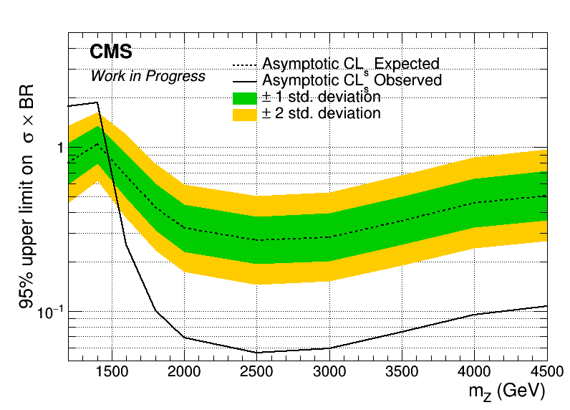
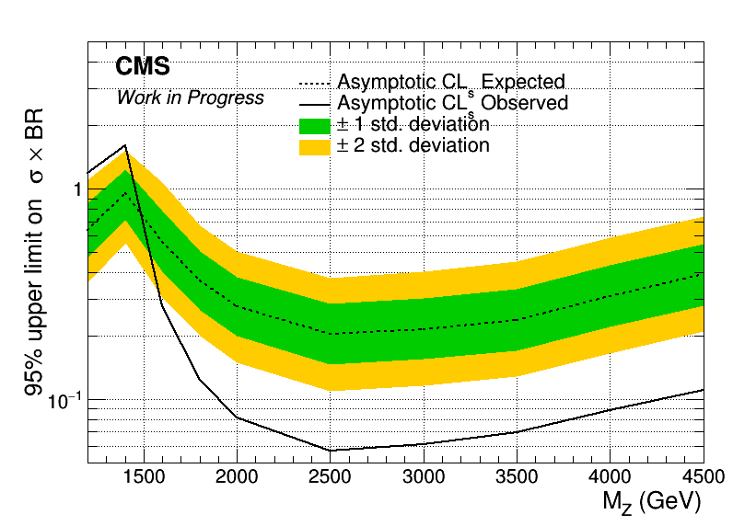
Angular Distributions (Brazilian Plot using data!!!!)
Assymptotic limits for M Z’: 1.2, 1.4, 1.6, 1.8, 2, 2.5, 3, 3.5, 4, 4.5 TeV
Width 1%
2017
2018

Slide 13
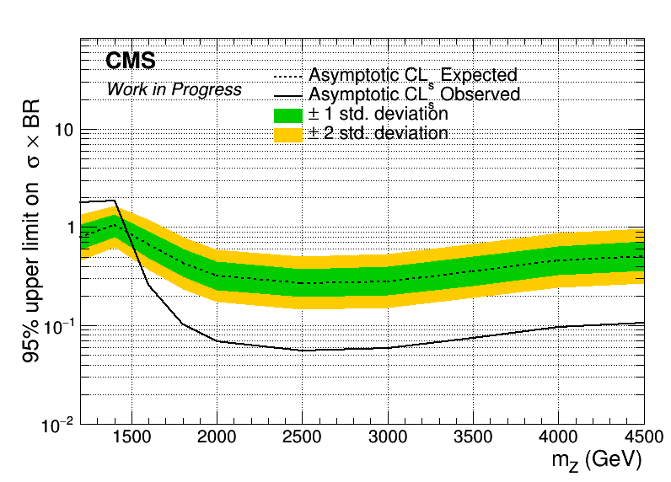
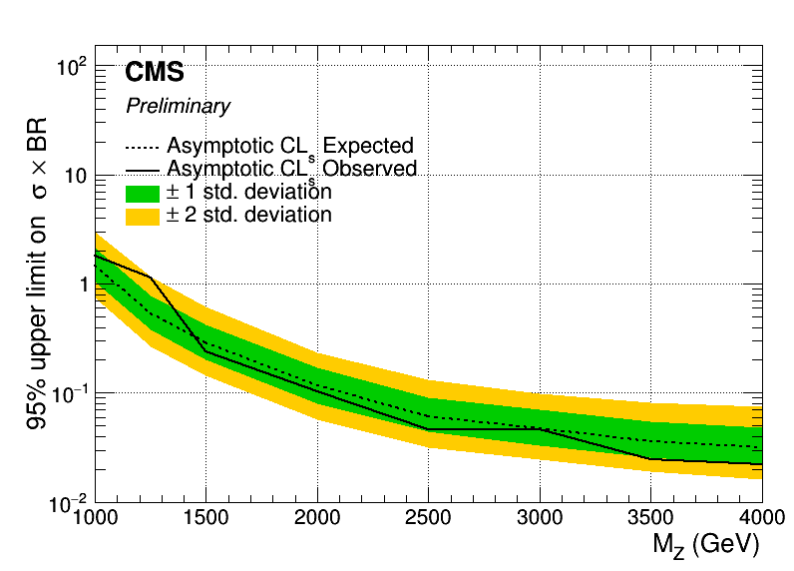
Angular Distributions (Brazilian Plot using extracted signal!!) vs B2G-16-015
Assymptotic limits for M Z’: 1.2, 1.4, 1.6, 1.8, 2, 2.5, 3, 3.5, 4, 4.5 TeV
Width 1%
2017
B2G-16-015

Slide 14
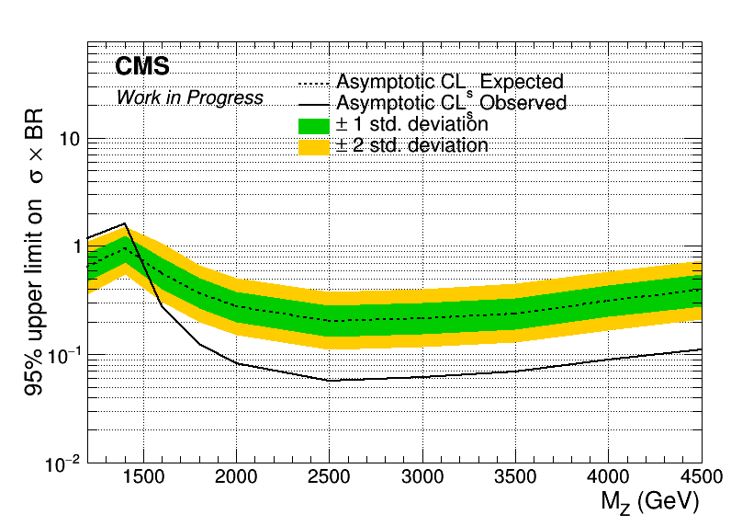
Angular Distributions (Brazilian Plot using extracted signal!!) vs B2G-16-015
Assymptotic limits for M Z’: 1.2, 1.4, 1.6, 1.8, 2, 2.5, 3, 3.5, 4, 4.5 TeV
Width 1%
2018
B2G-16-015

Slide 15
Signal Selection
Control Region Selection
Variables | Selected Cut
pT (both leading jets) | > 400 GeV
Njets | > 1
N leptons | = 0
|eta| (both leading jets) | < 2.4
mJJ | > 1000 GeV
jetMassSoftDrop (only for fit) | (50,300) GeV
Top Tagger | > 0.2, 0, 0.1
B tagging (2 btagged jets) | > Medium WP
Signal Trigger
Variables | Selected Cut
pT (both leading jets) | > 400 GeV
Njets | > 1
N leptons | = 0
|eta| (both leading jets) | < 2.4
mJJ | > 1000 GeV
jetMassSoftDrop (only for fit) | (50,300) GeV
Top Tagger | > 0.2, 0, 0.1
B tagging (0 btagged jets) | < Medium WP
Control Trigger

Slide 16
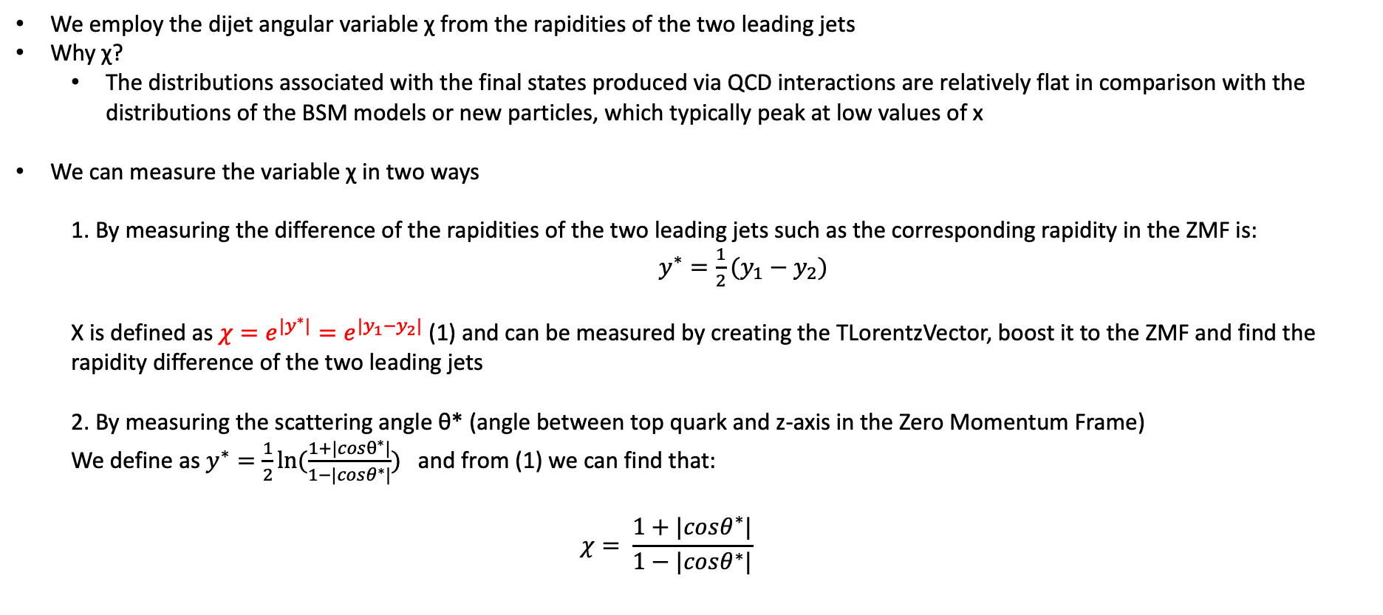
Top Angular Distributions
We employ the dijet angular variable χ from the rapidities of the two leading jets
Why χ?
The distributions associated with the final states produced via QCD interactions are relatively flat in comparison with the distributions of the BSM models or new particles, which typically peak at low values of x
We can measure the variable χ in two ways
1. By measuring the difference of the rapidities of the two leading jets such as the corresponding rapidity in the ZMF is: $y^{∗}=\frac{1}{2}(y_{1}−y_{2})$
Χ is defined as $χ=e^{{|y}^{∗}|}=e^{|y_{1}−y_{2}|}$ (1) and can be measured by creating the TLorentzVector, boost it to the ZMF and find the rapidity difference of the two leading jets
2. By measuring the scattering angle θ* (angle between top quark and z-axis in the Zero Momentum Frame)
We define as $y^{∗}=\frac{1}{2}ln⁡(\frac{1+|cosθ^{∗}|}{1−|cosθ^{∗}|})$ and from (1) we can find that:
$$χ= \frac{1+|cosθ^{∗}|}{1−|cosθ^{∗}|}$$

Slide 17
Significance Graphs (2017)
M_{z’} =1200, w = 1%
M_{z’} =1600, w = 1%
M_{z’} =1400, w = 1%
M_{z’} =1800, w = 1%

Slide 18
Significance Graphs (2017)
M_{z’} =2000, w = 1%
M_{z’} =3000, w = 1%
M_{z’} =2500, w = 1%
M_{z’} =3500, w = 1%

Slide 19
Significance Graphs (2017)
M_{z’} =4000, w = 1%
M_{z’} =4500, w = 1%

Slide 20
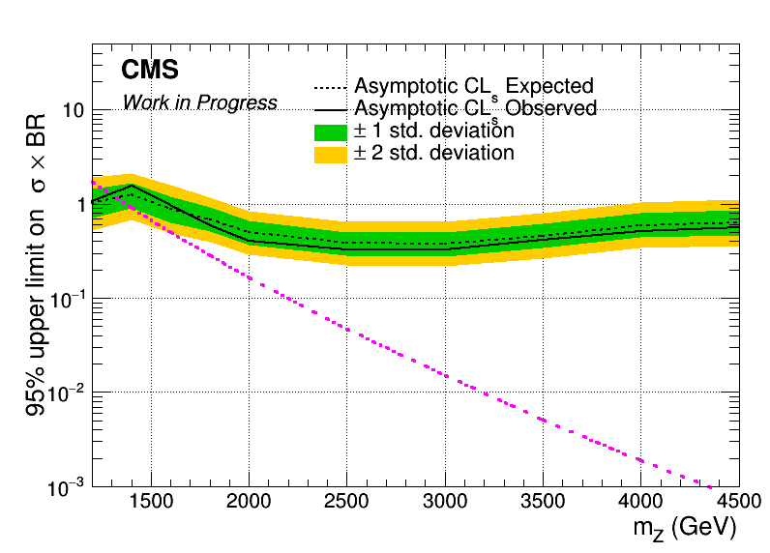
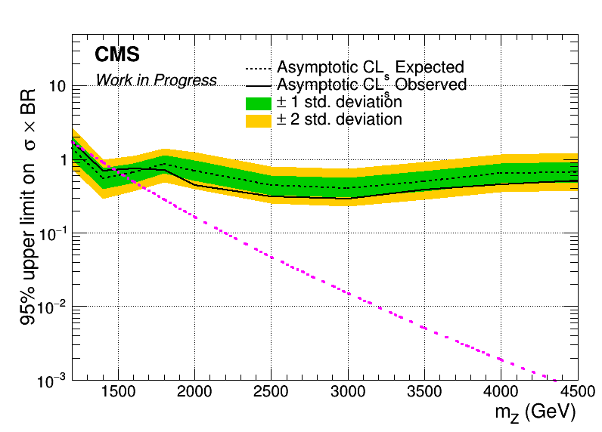
Brazilian Plots (2017)
mJJ > 1000 GeV
mJJ > 1200 GeV

Slide 21
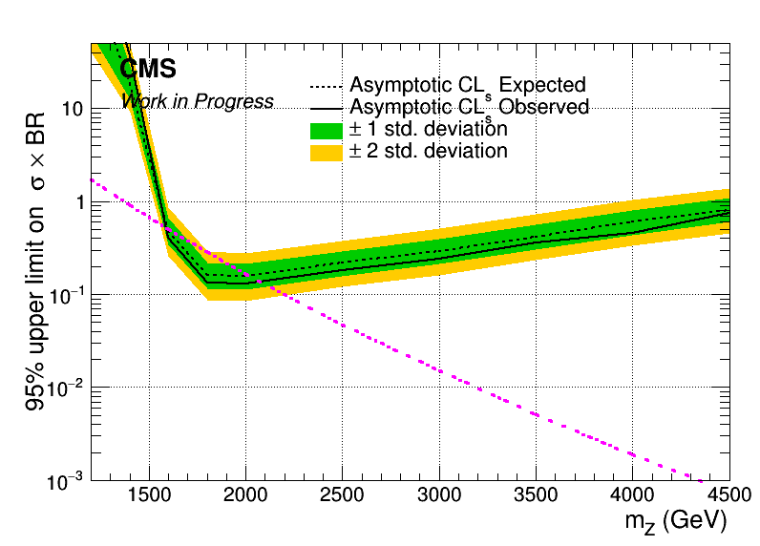
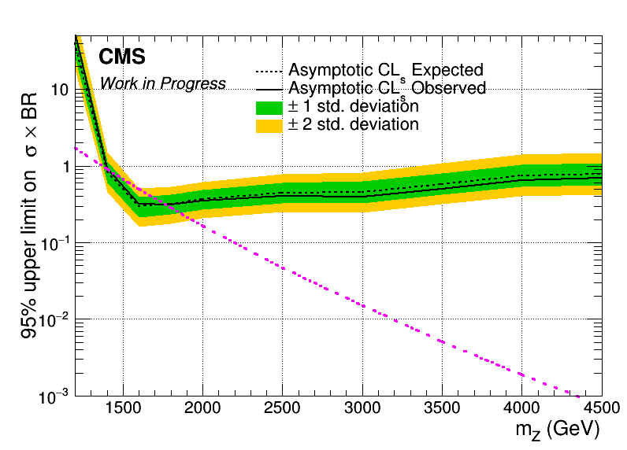

Asymptotic Limits - Brazilian Plots (2017)
mJJ > 1400 GeV
mJJ > 1600 GeV

Slide 22
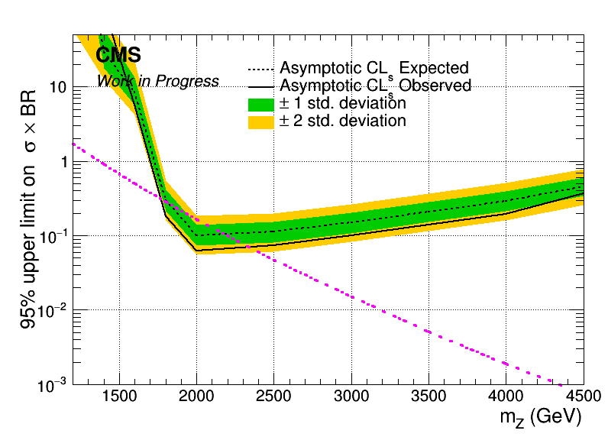
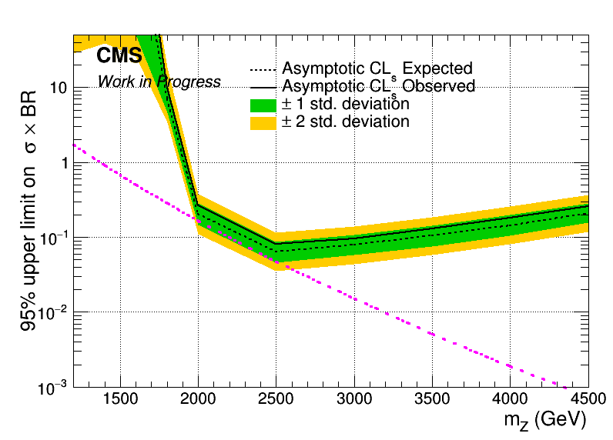
Brazilian Plots (2017)
mJJ > 1800 GeV
mJJ > 2000 GeV

